Slide 1
📊
Python
Data Visualization
Complete Teaching Deck with Line-by-Line Code Explanations
Platform: Google Colab | Libraries: Matplotlib - Seaborn - Plotly
Line
Bar
Histogram
Scatter
Box Plot
Violin
Pie
KAJOLA GBENGA ADEWALE
Area
Heatmap
Pair Plot
Count
Bubble
Plotly
Donut
Data Analytics Expert
Notes:
Title slide. This deck converts the full Python Data Visualization notebook into teaching slides. Every chart type has its own dedicated slide with (1) the SVG chart visual, (2) the actual code, and (3) a line-by-line explanation table. All code runs in Google Colab.

Slide 2
1. CORE PYTHON VISUALIZATION LIBRARIES
📊 Matplotlib
🎨 Seaborn
⚡ Plotly
alias: plt
alias: sns
alias: px
Low-level and very flexible. Foundation of most Python visualization libraries. Best for learning fundamentals and full customisation.
High-level statistical visualizations. Built on top of Matplotlib. Excellent for data analysis and teaching patterns with less code.
Interactive and web-friendly charts. Great for dashboards and storytelling. Charts can be zoomed, hovered, and embedded in web apps.
import matplotlib.pyplot as plt
import seaborn as sns
import plotly.express as px
Line
Explanation
Line
Explanation
Line
Explanation
import matplotlib.pyplot as plt
Imports Matplotlib and gives it the short alias 'plt'. Using an alias means you type plt.plot() instead of Matplotlib.pyplot.plot() every time.
import seaborn as sns
Imports Seaborn and gives it the short alias 'sns'. Using an alias means you type sns.plot() instead of Seaborn.pyplot.plot() every time.
import plotly.express as px
Imports Plotly and gives it the short alias 'px'. Using an alias means you type px.plot() instead of Plotly.pyplot.plot() every time.
Notes:
Three libraries - three purposes. Matplotlib is the foundation and is always imported first. Seaborn wraps Matplotlib to make statistical charts with far less code. Plotly creates interactive charts that open in the browser. Students should run all three import lines before any chart code.

Slide 3
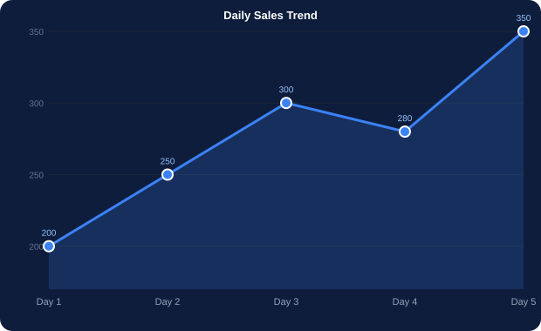
2. LINE CHART - Trends Over Time
line_chart.py
# Sample Data
days = [1, 2, 3, 4, 5]
sales = [200, 250, 300, 280, 350]
plt.plot(days, sales)
plt.xlabel('Days')
plt.ylabel('Sales')
plt.title('Daily Sales Trend')
plt.show()
Line of Code
What It Does
days = [1, 2, 3, 4, 5]
Creates the x-axis values. Each number is a day (1 = Day 1, etc.).
sales = [200, 250, 300, 280, 350]
Creates the y-axis values. Each number is the sales amount for that day.
plt.plot(days, sales)
Draws a line connecting each (day, sales) point in order.
Line Chart
plt.xlabel('Days')
Labels the x-axis so the reader knows what each value represents.
When to use:
plt.ylabel('Sales')
Labels the y-axis so the reader knows the unit of measurement.
Time series data
plt.title('Daily Sales Trend')
Adds a title at the top of the chart.
Continuous data trends
Change over days/months/years
plt.show()
Renders and displays the chart in the output cell.
Real use cases:
Stock prices over time
Monthly sales growth
Temperature changes
Notes:
Line chart. The key concept: plt.plot() connects points in the order they appear in the list. If the x-axis is NOT in order, the line will zig-zag unexpectedly. Always sort your data before plotting a line chart.

Slide 4
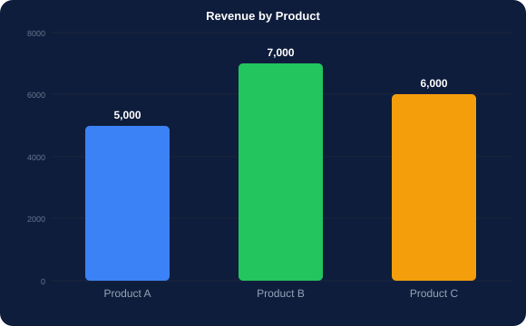
3. BAR CHART - Comparing Categories
bar_chart.py
products = ['A', 'B', 'C']
revenue = [5000, 7000, 6000]
plt.bar(products, revenue)
plt.title('Revenue by Product')
plt.xlabel('Products')
plt.ylabel('Revenue')
plt.show()
Line of Code
What It Does
products = ['A', 'B', 'C']
Defines the categories to appear on the x-axis.
revenue = [5000, 7000, 6000]
Defines the height of each bar (revenue per product).
plt.bar(products, revenue)
Creates vertical bars - one bar per product, height = revenue.
Bar Chart
plt.title(...)
Sets the chart title displayed at the top.
When to use:
plt.xlabel('Products')
Labels the x-axis (the categories axis).
Comparing discrete categories
plt.ylabel('Revenue')
Labels the y-axis (the values axis).
Ranked values side by side
plt.show()
Renders and displays the chart.
Discrete (non-continuous) data
Real use cases:
Revenue by product
Students per department
Votes per candidate
Notes:
Bar chart. plt.bar() is for vertical bars. Use plt.barh() for horizontal bars (better when category names are long). Always sort bars from highest to lowest for easier comparison - use sorted() on the data before plotting.

Slide 5
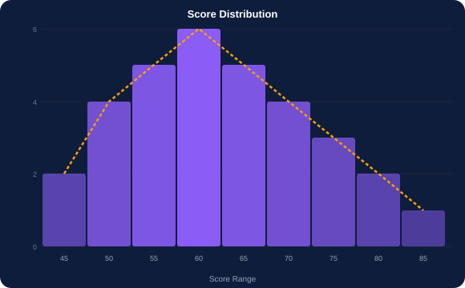
4. HISTOGRAM - Frequency Distribution
histogram.py
scores = [45, 50, 55, 60, 65, 70, 75, 80, 85]
plt.hist(scores, bins=5)
plt.title('Score Distribution')
plt.show()
Line of Code
What It Does
scores = [45, 50, ... 85]
The dataset - a list of exam scores to analyze.
plt.hist(scores, bins=5)
Creates a histogram. bins=5 divides the data range into 5 groups (buckets). Each bar shows how many scores fall in that group.
Histogram
bins=5
Controls how many groups the data is split into. More bins = more detail. Fewer bins = smoother shape. Try different values.
When to use:
plt.title('Score Distribution')
Adds the chart title.
Distribution of a single variable
Key difference from Bar Chart
Frequency analysis
Key difference from Bar Chart
plt.show()
Renders and displays the chart.
Bar chart compares CATEGORIES. Histogram shows the DISTRIBUTION of a single numeric variable split into ranges.
How often values appear in ranges
Bar chart compares CATEGORIES. Histogram shows the DISTRIBUTION of a single numeric variable split into ranges.
Real use cases:
Exam scores distribution
Age distribution of customers
Income distribution analysis
Notes:
Histogram vs Bar chart: the most common confusion. A bar chart compares separate categories (Product A, B, C). A histogram shows ONE continuous variable divided into ranges (bins). The number of bins dramatically changes how the chart looks - always experiment.

Slide 6
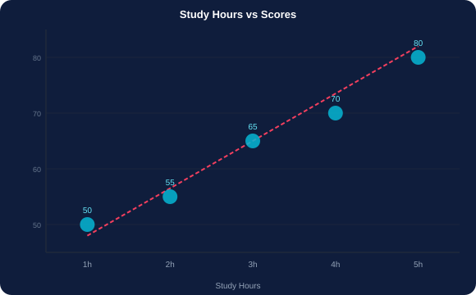
5. SCATTER PLOT - Relationship Between Two Variables
scatter.py
hours = [1, 2, 3, 4, 5]
scores = [50, 55, 65, 70, 80]
plt.scatter(hours, scores)
plt.xlabel('Study Hours')
plt.ylabel('Scores')
plt.title('Study Hours vs Scores')
plt.show()
Line of Code
What It Does
hours = [1, 2, 3, 4, 5]
X-axis values - number of hours studied.
scores = [50, 55, 65, 70, 80]
Y-axis values - exam score for each student.
plt.scatter(hours, scores)
Plots one dot per student at position (hours, score). Does NOT connect dots - that is the key difference from a line chart.
Scatter Plot
plt.xlabel('Study Hours')
Labels the x-axis.
When to use:
plt.ylabel('Scores')
Labels the y-axis.
Relationship between 2 numeric variables
plt.title(...)
Sets the chart title.
Correlation detection (positive/negative/none)
Identify clusters and outliers
plt.show()
Displays the chart.
Real use cases:
Height vs Weight
Advertising spend vs Sales
Study hours vs Exam scores
Notes:
Scatter plot. The red dashed trend line in the chart visual represents a linear regression line. Adding color parameter (c=category_list) turns a scatter into a bubble chart coloured by group - heavily used in EDA. Correlation: dots rising left to right = positive correlation.

Slide 7
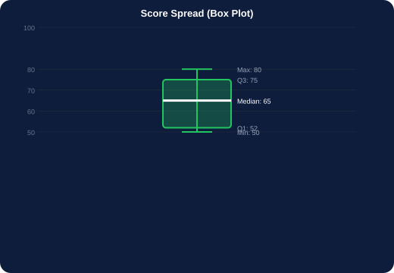
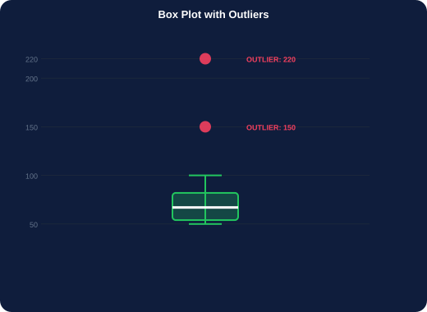
6. BOX PLOT - Spread, Quartiles, and Outliers
Code
Explanation
scores = [...]
Your dataset.
sns.boxplot()
Draws the box. Shows median, Q1, Q3, min, max.
data=[scores]
Wraps data in a list for Seaborn's expected format.
Box Plot Anatomy
plt.title(...)
Adds the chart title.
Top whisker:
Max value (non-outlier)
plt.show()
Displays the chart.
Top of box:
Q3 - 75th percentile
Middle line:
Median (50th pct)
box_plot.py
box_outliers.py
Bottom of box:
Q1 - 25th percentile
scores = [50, 55, 65, 70, 80]
sns.boxplot(data=[scores])
plt.title('Score Spread')
plt.show()
# With outliers
scores = [50,55,65,70,80,100,150,220]
sns.boxplot(data=[scores])
plt.title('Score Spread with Outliers')
plt.show()
Bottom whisker:
Min value (non-outlier)
Dots beyond:
Outliers
Notes:
Box plot. The box itself contains the middle 50% of the data. The line inside the box is the median. Outliers (220 in the second example) appear as dots beyond the whiskers. sns.boxplot() is from Seaborn - notice we import seaborn as sns and use sns.boxplot(), but still use plt.title() and plt.show().

Slide 8
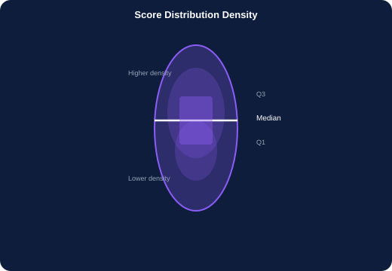
7. VIOLIN PLOT - Distribution and Density Combined
violin.py
scores = [50, 55, 65, 70, 80]
sns.violinplot(data=scores)
plt.title('Score Distribution Density')
plt.show()
Line of Code
What It Does
scores = [...]
The numeric dataset to visualize.
sns.violinplot(data=scores)
Creates the violin plot. The shape shows WHERE data is concentrated - wider sections have more data points.
The violin shape
Outer edges = kernel density curve (KDE). Inside = a mini box plot. Wide middle = many values clustered there.
Violin Plot
plt.title(...)
Adds the chart title.
When to use:
Show distribution PLUS density in one chart
Violin vs Box Plot
plt.show()
Displays the chart.
Box plot shows 5 summary statistics. Violin shows the entire distribution shape. Violin is better when you suspect the data has multiple peaks (bimodal distribution).
More informative than a box plot
Reveal bimodal (two-peaked) distributions
Real use cases:
Customer spending patterns
Exam score distributions by class
Salary ranges across departments
Notes:
Violin plot. The width of the violin at any height tells you how many data points exist at that value. The narrow parts have few data points. The widest part is where most data clusters. Use violin when you want to show the full story, not just summary statistics.

Slide 9
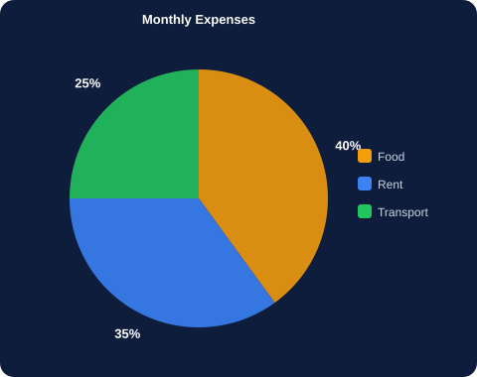
8. PIE CHART - Parts of a Whole
pie_chart.py
items = ['Food', 'Rent', 'Transport']
sizes = [40, 35, 25]
plt.pie(
sizes,
labels=items,
autopct='%1.1f%%'
)
plt.title('Monthly Expenses')
plt.show()
Line of Code
What It Does
items = [...]
Category names. Each item becomes a slice label.
sizes = [40, 35, 25]
The size of each slice. These must add up to 100 (or any total - Matplotlib auto-calculates percentages).
plt.pie(sizes, ...)
Creates the pie chart using the sizes list for slice proportions.
labels=items
Displays each category name next to its slice.
Pie Chart
autopct='%1.1f%%'
Automatically adds percentages inside each slice. %1.1f means 1 decimal place.
When to use:
plt.title(...)
Adds the chart title.
Part-to-whole relationship
plt.show()
Displays the chart.
Small number of categories (max 5-6)
One slice clearly dominates
Real use cases:
Market share breakdown
Monthly budget allocation
Product sales proportion
Notes:
Pie chart rules. Only use pie when you have 5 or fewer categories and one slice is clearly dominant. If all slices look similar in size, switch to a bar chart - humans are poor at judging angles but good at comparing bar heights. Always use autopct to show percentages.

Slide 10
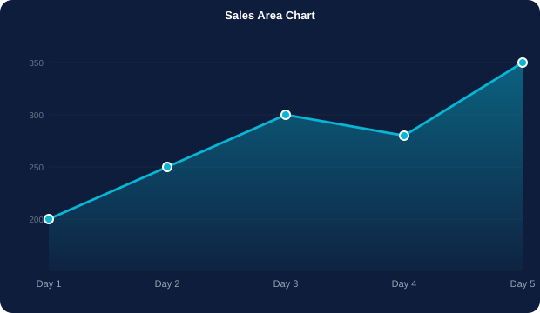
9. AREA CHART - Cumulative Trends Over Time
area_chart.py
days = [1, 2, 3, 4, 5]
sales = [200, 250, 300, 280, 350]
plt.fill_between(days, sales)
plt.title('Sales Area Chart')
plt.show()
Line of Code
What It Does
days = [1, 2, 3, 4, 5]
X-axis values representing time points.
sales = [200, 250, 300, 280, 350]
Y-axis values - the sales amount at each time point.
plt.fill_between(days, sales)
This is the KEY command. It fills the area between the line and the x-axis (y=0). Creates the shaded area effect.
Area Chart
plt.fill_between(x, y)
First argument: x values. Second argument: y values. Python fills from x-axis UP to the y values.
When to use:
Cumulative trends and totals
plt.title(...)
Adds the chart title.
Time-based comparisons
Line Chart vs Area Chart
plt.show()
Displays the filled area chart.
Line chart: plt.plot(x, y). Area chart: plt.fill_between(x, y). Area emphasises VOLUME - how much total value exists, not just direction.
Emphasise volume, not just direction
Real use cases:
Revenue growth over months
Population growth over years
Website traffic accumulation
Notes:
Area chart. fill_between() can also fill between two lines: fill_between(x, y1, y2) shades between the two curves. This is useful for showing a range or confidence interval. The alpha parameter controls transparency: fill_between(x, y, alpha=0.5).

Slide 11
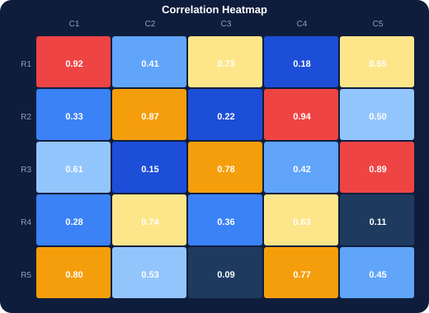
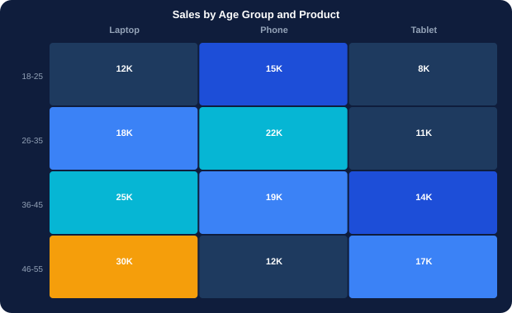
10. HEATMAP - Patterns in a Matrix of Values
heatmap_basic.py
# Basic heatmap
import numpy as np
data = np.random.rand(5, 5)
sns.heatmap(data, annot=True)
plt.title('Correlation Heatmap')
plt.show()
When to use:
Real use cases:
Line of Code
What It Does
import numpy as np
Imports NumPy for numerical computation.
np.random.rand(5, 5)
Generates a 5x5 matrix of random values between 0 and 1. In practice, this would be your real data or a correlation matrix.
sns.heatmap(data, annot=True)
Creates the heatmap. annot=True prints the actual numeric value inside each cell so the reader does not have to guess from colour alone.
Color = value
Darker or brighter colors = higher or lower values, depending on the cmap (colour map) chosen.
heatmap_sales.py
# Sales Age Segmentation Heatmap
heat = df.pivot_table(index='Age_Group', columns='Product', values='Sales', aggfunc='sum')
sns.heatmap(heat, annot=True, fmt='g', cmap='Blues')
plt.show()
Displays the chart.
Notes:
Heatmap. The most important Seaborn parameters: annot=True to show numbers, fmt='.2f' for 2 decimal places, cmap='Blues' or 'coolwarm' or 'viridis' for different colour schemes. pivot_table() reshapes a DataFrame from long format to a matrix - required before sns.heatmap().

Slide 12
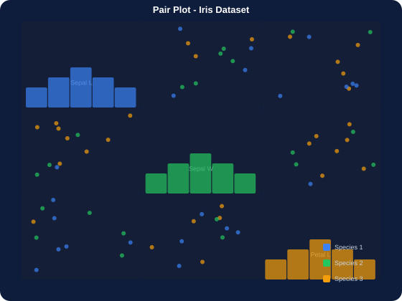
11. PAIR PLOT - All Variable Relationships at Once
pairplot.py
sns.pairplot(sns.load_dataset('iris'))
plt.show()
Line of Code
What It Does
sns.load_dataset('iris')
Loads the famous Iris dataset (150 flowers, 4 measurements + species). A built-in Seaborn example dataset.
sns.pairplot(...)
Creates an N x N grid of charts where N = number of numeric variables. The diagonal shows histograms. Every other cell shows a scatter plot of two variables.
Why N x N grid
With 4 variables (Sepal L, Sepal W, Petal L, Petal W), pairplot creates 16 charts automatically - one for every variable combination.
Colors per species
Pair Plot
Seaborn automatically assigns different colors to each species, making clusters instantly visible.
When to use:
plt.show()
Displays all the sub-plots together.
Multivariate Exploratory Data Analysis (EDA)
Find which variables are correlated
Spot clusters and class separation before ML
Real use cases:
Feature selection for Machine Learning
Checking assumptions before regression
Identifying key signals in the data
Notes:
Pair plot. One of the most powerful single-line commands in data science. sns.pairplot() in one line does what would take 20+ lines with Matplotlib. It is the standard first chart a data scientist creates on a new dataset. The hue parameter (hue='species') adds colour by class.

Slide 13
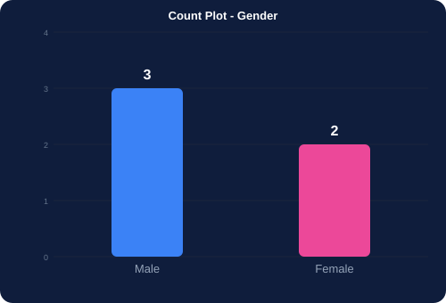
12. COUNT PLOT - Frequency of Categorical Data
countplot.py
data = ['Male','Female','Male','Female','Male']
sns.countplot(x=data)
plt.show()
Line of Code
What It Does
data = ['Male','Female',...]
A list of categorical values. Can also be a DataFrame column: x=df['column'].
sns.countplot(x=data)
Counts how many times each unique value appears and draws a bar for each. No need to count manually - Seaborn does it automatically.
x=data
Passing x= means the categories go on the x-axis (vertical bars). Use y=data for horizontal bars.
Count Plot
Output the chart produces:
plt.show()
Displays the chart.
When to use:
Category
Count
Counting occurrences of each category
Male
3
Showing which category appears most
Female
2
Quick frequency analysis of text/label data
Real use cases:
Gender distribution in a survey
Most popular product category
Count of customers per region
Notes:
Count plot. The simplest Seaborn chart. df['column'].value_counts() gives the same numbers as a table. sns.countplot() visualises them as bars automatically. Add hue='gender' to split bars by a second category (grouped count plot).

Slide 14
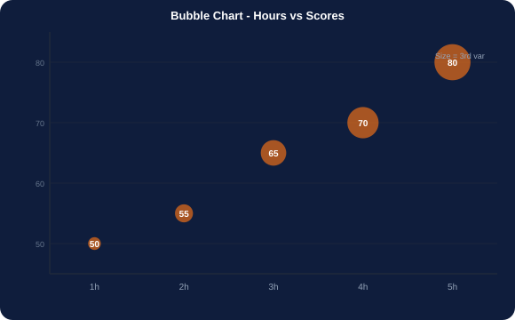
13. BUBBLE CHART - Three Variables in One View
bubble_chart.py
hours = [1, 2, 3, 4, 5]
scores = [50, 55, 65, 70, 80]
plt.scatter(
hours,
scores,
s=[50, 100, 200, 300, 400]
)
plt.show()
Line of Code
What It Does
hours = [1, 2, 3, 4, 5]
X-axis values - first variable.
scores = [50, 55, 65, 70, 80]
Y-axis values - second variable.
s=[50, 100, 200, 300, 400]
SIZE of each bubble - the third variable. Larger s value = larger circle. This is what makes it a bubble chart instead of a regular scatter plot.
Bubble Chart
When to use:
plt.scatter(..., s=[...])
A bubble chart IS a scatter plot. The only difference is passing s= with different values per point so bubbles have different sizes.
3-variable relationship on one chart
The s parameter meaning
Show size as a third dimension
plt.show()
Displays the chart.
s usually represents a third variable. Example: Hours studied (x) vs Scores (y) vs Number of practice tests taken (s). Bigger bubble = more practice tests.
Extend scatter plot with magnitude info
Real use cases:
GDP vs Population vs Life Expectancy
Hours vs Scores vs Number of Practice Tests
Ad spend vs Clicks vs Conversion Rate
Notes:
Bubble chart. The s parameter takes either a single value (all bubbles same size) or a list (each bubble its own size). To make size proportional to a data column: s=df['column']*10. Always add a legend explaining what bubble size means - the audience cannot guess.

Slide 15
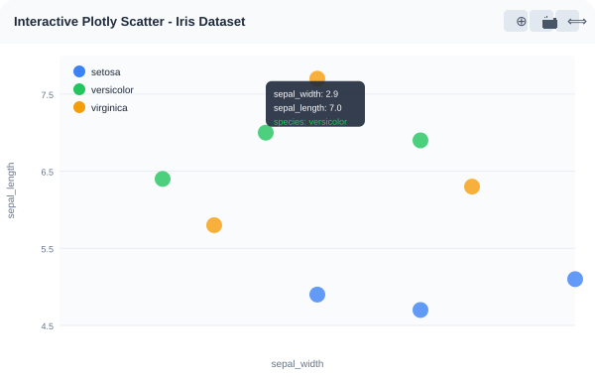
14. INTERACTIVE CHARTS WITH PLOTLY
plotly_scatter.py
df = px.data.iris()
fig = px.scatter(
df,
x='sepal_width',
y='sepal_length',
color='species'
)
fig.show()
Line of Code
What It Does
df = px.data.iris()
Loads the built-in Iris dataset into a Pandas DataFrame. px.data has several built-in sample datasets.
px.scatter(df, ...)
Creates an interactive scatter plot using Plotly Express. Returns a Figure object stored in fig.
x='sepal_width'
Specifies the DataFrame column to use on the x-axis.
y='sepal_length'
Specifies the DataFrame column to use on the y-axis.
Plotly Interactive Charts
color='species'
Colours each dot by the species column. Automatically adds a legend. Each species gets a unique colour.
When to use:
Need zoom, pan, and hover tooltips
fig.show()
Renders the interactive chart in the Colab output. You can hover, zoom, and pan the chart.
Matplotlib vs Plotly: plt.show() shows a static image. fig.show() shows an interactive chart you can click and explore.
Presenting to non-technical stakeholders
Embedding in web dashboards and reports
Real use cases:
Interactive EDA in Jupyter / Colab
Sales dashboards with hover data
Presenting findings to management
Notes:
Plotly vs Matplotlib. The key conceptual shift: Matplotlib returns a static image. Plotly returns a Figure object (fig) that you display with fig.show(). In Colab, fig.show() renders an interactive HTML chart directly in the cell output. Hover over any data point to see its values.

Slide 16
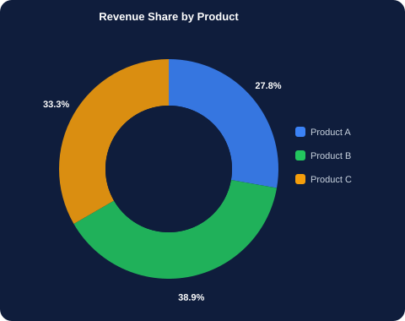
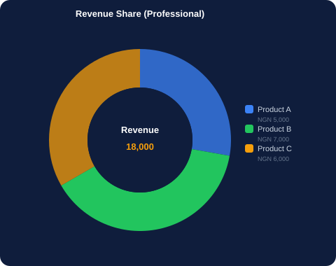
15. DONUT CHART - Pie with a Centre Label
15a. Basic Donut Chart
15b. Professional Donut with Centre Text
donut_basic.py
donut_pro.py
plt.figure(figsize=(6, 6))
plt.pie(
revenue, labels=products,
autopct='%1.1f%%', startangle=90,
wedgeprops=dict(width=0.4)
)
plt.axis('equal'); plt.show()
fig, ax = plt.subplots(figsize=(7, 7))
ax.pie(revenue, labels=products,
autopct='%1.1f%%', startangle=90,
wedgeprops=dict(width=0.4))
ax.text(0, 0, 'Revenue\n18,000',
ha='center', va='center',
fontsize=14, fontweight='bold')
plt.show()
fig, ax = plt.subplots()
The professional way to create Matplotlib charts. Returns a Figure and Axes object so you have full control.
ax.text(0, 0, 'text')
Adds text at the center of the donut (x=0, y=0 is the center of the pie coordinate system).
plt.axis('equal')
Ensures the chart stays a circle, not an oval.
wedgeprops=dict(width=0.4)
THIS creates the donut hole. width controls ring thickness: 0.0 = full hole (nothing), 1.0 = full pie (no hole). 0.4 is a common value.
Key Parameter
What It Does
Notes:
Donut chart. The ONLY difference between pie and donut is wedgeprops=dict(width=0.4). Everything else is the same as a pie chart. The centre text (ax.text) is at coordinate (0,0) because pie charts are drawn on a unit circle centred at the origin. startangle=90 starts the first slice at the top (12 o'clock position).

Slide 17
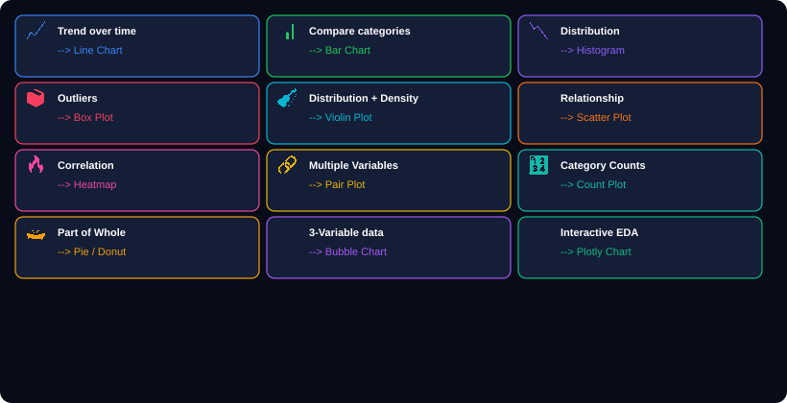
KEY VISUALIZATION RULE - Choose the Right Chart
Notes:
The chart selection rule table. Print this slide for students. The question is always: what is my GOAL? Trend over time = Line. Compare categories = Bar. Distribution = Histogram. Outliers = Box Plot. Relationship = Scatter. Correlation = Heatmap. Multiple variables = Pair Plot. Category counts = Count Plot. Part of whole = Pie / Donut. 3 variables = Bubble. Interactive = Plotly.

Slide 18
NOTE - Most Important Charts for Data Science and ML
📉 Histogram
⚡ Scatter Plot
Why essential for Data Science:
Why essential for Data Science:
Understand the distribution of each feature before modelling. Is it normal? Skewed? Bimodal?
Visualise relationships between two numerical variables. Used to detect correlation and clusters before applying regression.
📦 Box Plot
🔥 Heatmap
Why essential for Data Science:
Why essential for Data Science:
Detect and visualise outliers in each feature. Outliers must be handled before training ML models.
Show the correlation matrix of all numeric features. High correlation between features (multicollinearity) affects regression models.
🔗 Pair Plot
🔢 Count Plot
Why essential for Data Science:
Why essential for Data Science:
The ultimate EDA tool. Shows all variable relationships in one command. Used to identify which features are predictive.
Check class imbalance in the target variable. If one class has far more samples than others, the ML model will be biased.
Notes:
The six essential charts for Data Science and ML. These are not just visualisation tools - they are diagnostic tools. Run all six on every new dataset before building any model. They reveal data quality issues, feature relationships, class imbalance, and outliers that would otherwise silently degrade model performance.

Slide 19
QUICK REFERENCE - All Chart Commands
Line Chart
Box Plot
Interactive Scatter
plt.plot(x, y)
sns.boxplot(data=[scores])
px.scatter(df, x=..., y=..., color=...)
Bar Chart
Violin Plot
Donut Chart
plt.bar(x, y)
sns.violinplot(data=scores)
plt.pie(..., wedgeprops=dict(width=0.4))
Histogram
Heatmap
plt.hist(data, bins=n)
sns.heatmap(data, annot=True)
Scatter Plot
Pair Plot
plt.scatter(x, y)
sns.pairplot(df)
Pie Chart
Count Plot
plt.pie(sizes, labels=..., autopct=...)
sns.countplot(x=data)
Area Chart
plt.fill_between(x, y)
Bubble Chart
plt.scatter(x, y, s=[...])
Notes:
Quick reference cheat sheet. Print this and give to every student. The pattern is consistent: Matplotlib commands start with plt. Seaborn commands start with sns. Plotly Express commands start with px. Every chart ends with plt.show() for Matplotlib/Seaborn or fig.show() for Plotly.

Slide 20
📊
Python Data Visualization
Teaching Deck Complete
14 chart types covered:
Line
Bar
Histogram
Scatter
Box Plot
Violin
Pie
Area
Heatmap
Pair Plot
Count Plot
Bubble
Plotly
Donut
You can now build 14 chart types using Matplotlib, Seaborn, and Plotly.
Kajola Gbenga Adewale
Data Analytics Expert
Next: Data Cleaning + Advanced EDA + Machine Learning with Scikit-Learn
Notes:
Closing slide. Students have covered every chart type in the notebook with full code + line-by-line explanations. Remind them: the chart selection guide on Slide 17 is the reference to keep. The most common mistake is choosing a chart first and then finding data to fit it - always choose data goal first, then chart type.

